Slide 1

Planning and conducting investigations using fair testing

Slide 2

The steps of planning and conducting an investigation.
Question for investigation
Make a prediction
Plan a fair test
Conduct your investigation
Notes:
Note: This slideshow is colour-coded so that individual elements of planning and conducting can be considered, as well as the investigation in its entirety. Some or all of the slideshow can be used to meet pedagogical needs.

Slide 3
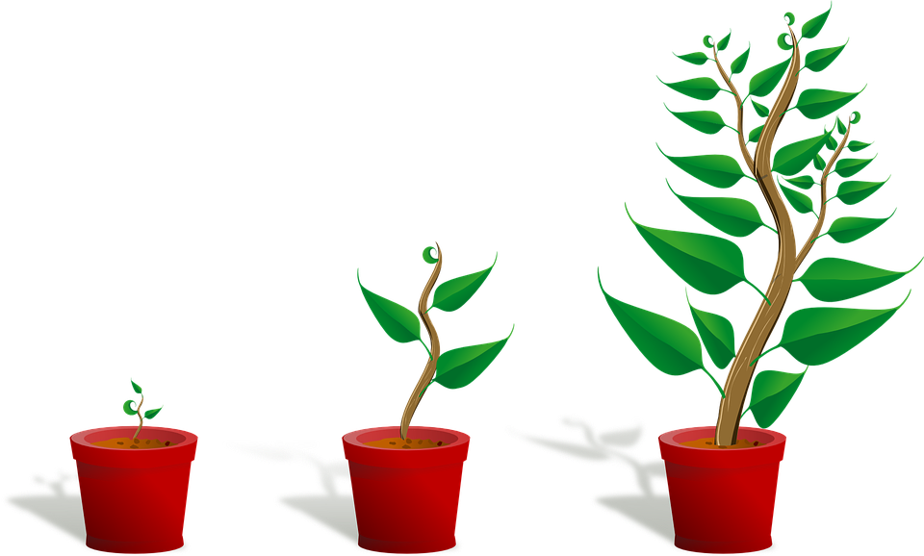


Planning and conducting
You want to test if this brand of fertiliser really does make plants grow taller.
Plant GRO
Make your plants grow taller!

Slide 4

First you would think of a question to investigate.
What happens to plant growth when I add the fertiliser to the potting mix?

Slide 5
Then make a prediction.
If I add fertiliser
to the soil
then the plant will grow taller because it will have more nutrients.

Slide 6

If you are to rely upon your results, it is important for any experiment to be a fair test.

Slide 7
A test is fair if you only change one variable.
This plant will have NO fertiliser
Add fertiliser
ONLY
to this plant
A
B

Slide 8
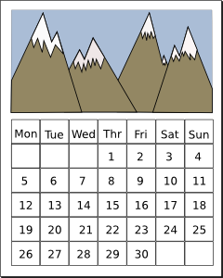
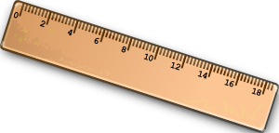
And then measure one variable.
The variable you measure is what you can observe using your senses. For example:
height
length
speed
colour change
sound level.
In this example we are measuring how tall the plants grow over a length of time.
A
B

Slide 9
All other variables stay the same.
You would add the fertiliser to one plant pot and keep everything else the same as the other pot.
For example:
the type and size of pot
the type of potting mix
the type and size of plant
the amount of water each plant receives
the location you leave the plants in
the length of time of the experiment
the equipment you use and the way you measure each plant’s growth.
This plant has no fertiliser.
This plant is exactly the same but has fertiliser.
A
B

Slide 10

Plan and follow the method
change
Measure and record the height of the two plants.
Label the plants ‘A’ and ‘B’.
Add fertiliser to Plant ‘B’.
Put both plants in the same sunny position.
Give each plant the same amount of water each day.
Measure the height of each plant at the end of two weeks.
Identify which plant has grown the most.
measure
same

Slide 11
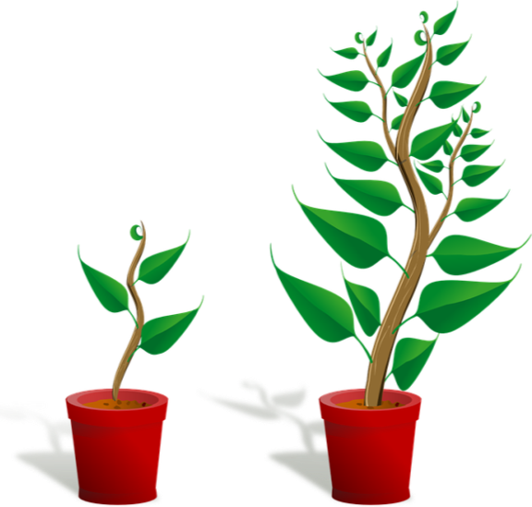

Make your observations.
A
B

Slide 12


Take very careful measurements so your data is accurate.
A
B

Slide 13

You can compare the results from different groups in your class for more reliable data.
No fertiliser added
A
A
A
A
A
Fertiliser added
B
B
B
B
B
All other variables stay the same.

Slide 14


This is a fair test.
You can conclude from your observations that Plant B has grown the tallest because of the fertiliser.
A
B

Slide 15




Attributions
https://pixabay.com/en/sapling-plant-growing-seedling-154734/
http://www.clker.com/clipart-paper-bag-lunch.html
http://www.clker.com/clipart-14919.html
http://www.clker.com/clipart-ruler.html

